Slide 1
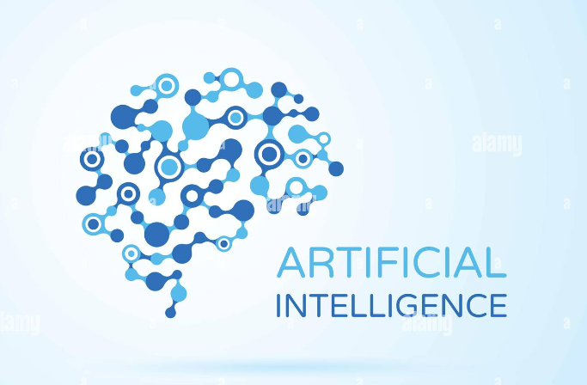
Introducing (AI)
Created By
Nusrat Jahan Anka
All Rights reserved by Nusrat Jahan Anka (Nusrat Anka)

Slide 2

Introduction
History
Types of AI
Is Acting Like Human
Current Status
Challenges
AI Applications
Achievements
How AI Works
Future of AI
Conclusion
References

Slide 3
Introduction
Artificial intelligence leverages computers and machines to mimic the problem-solving and decision-making capabilities of the human mind.

Slide 4
History
The time when it all started
Computers became faster & affordable
Landmark of AI
1950
1955
1974
1980
2000
John McCarthy coined term AI
The year of AI

Slide 5
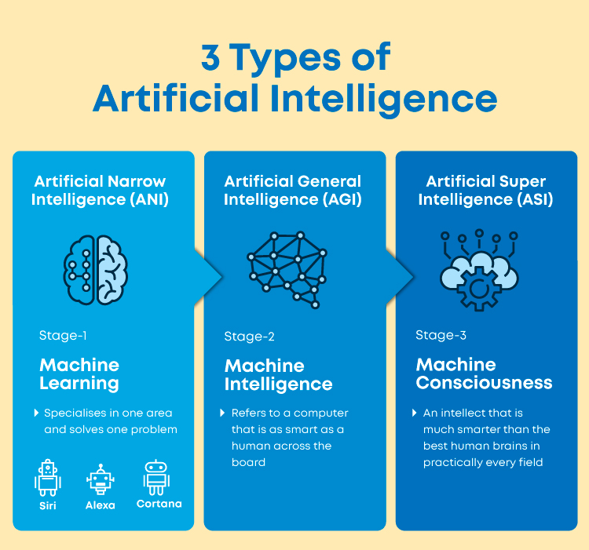
Types of AI

Slide 6
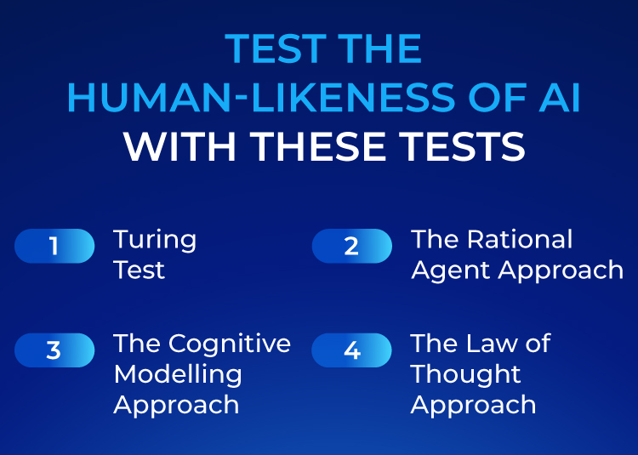
Is Acting Like Human

Slide 7
Current Status
AI have taken many shapes & forms over recent years.
Mobile Phones
Video games characters
GPS/Voice recognition
Robotics

Slide 8
Challenges
Computing Power
Tolerance Power
Intuitive Thinking
Judging Power
Can’t Handle Emergency Situation
Slow Real Time Response

Slide 9
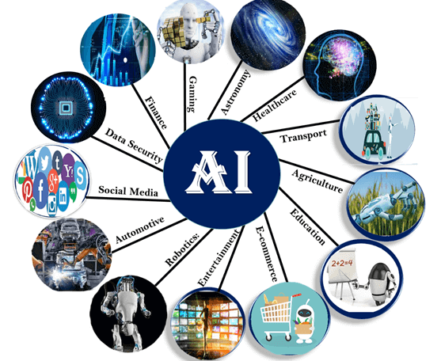
AI Applications

Slide 10
Achievements
DARPA grand challenge - 123 through the desert.
DARPA urban challenge - Autonomous driving in traffic.
Deep thought is an international grandmaster chess player.

Slide 11
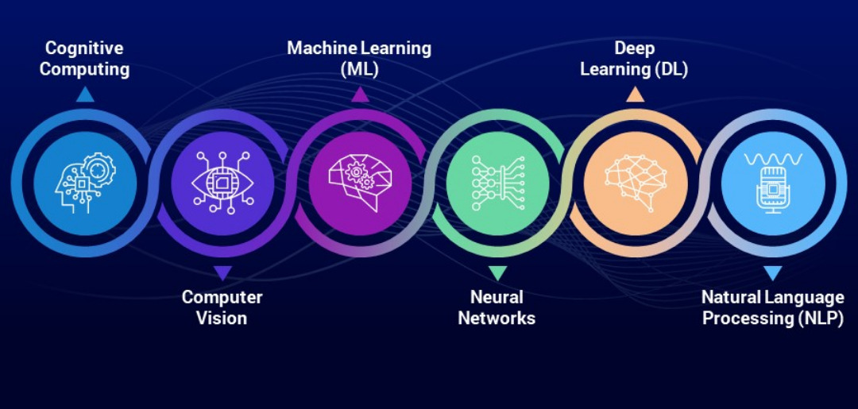
How AI Works

Slide 12
Future of AI
As humans, we have always been fascinated by technological changes and fiction, right now, we are living amidst the greatest advancements in our history. Though the Future is really unknown. Researchers seems to disagree on a lot of the same issues. But we can imagine two different kind of future of AI.
Positive
Negative

Slide 13
Conclusion
Human approach:
Systems that think like humans
Systems that act like humans
Ideal approach:
Systems that think rationally
Systems that act rationally

Slide 14
References
What is Artificial Intelligence (AI)?
ARTIFICIAL INTELLIGENCE BASIC PPT - SlideShare
What is Artificial Intelligence ( AI) in 2023? - Great Learning
Power Point Presentation on Artificial Intelligence - SlideShare
Application of AI - Javatpoint
artificial intelligence - SlideShare
Artificial Intelligence(AI). - SlideShare

